Slide 1

Spinal Cord Project Ideas
By Team Astra

Slide 2
What is our objective?
Our objective is to uncover subtle changes even before they become visible to the naked eye. Imagine a sophisticated system meticulously crafted to identify pathologies during routine tests and screenings, seamlessly integrating into our healthcare practices. In the realm of computer technology, these discoveries can be further enhanced, transforming the way we learn anatomy and enabling us to pinpoint anatomical landmarks with remarkable speed and precision. By leveraging advanced algorithms, we can unlock a new dimension of medical insight, enriching our understanding of the human body.

Slide 3
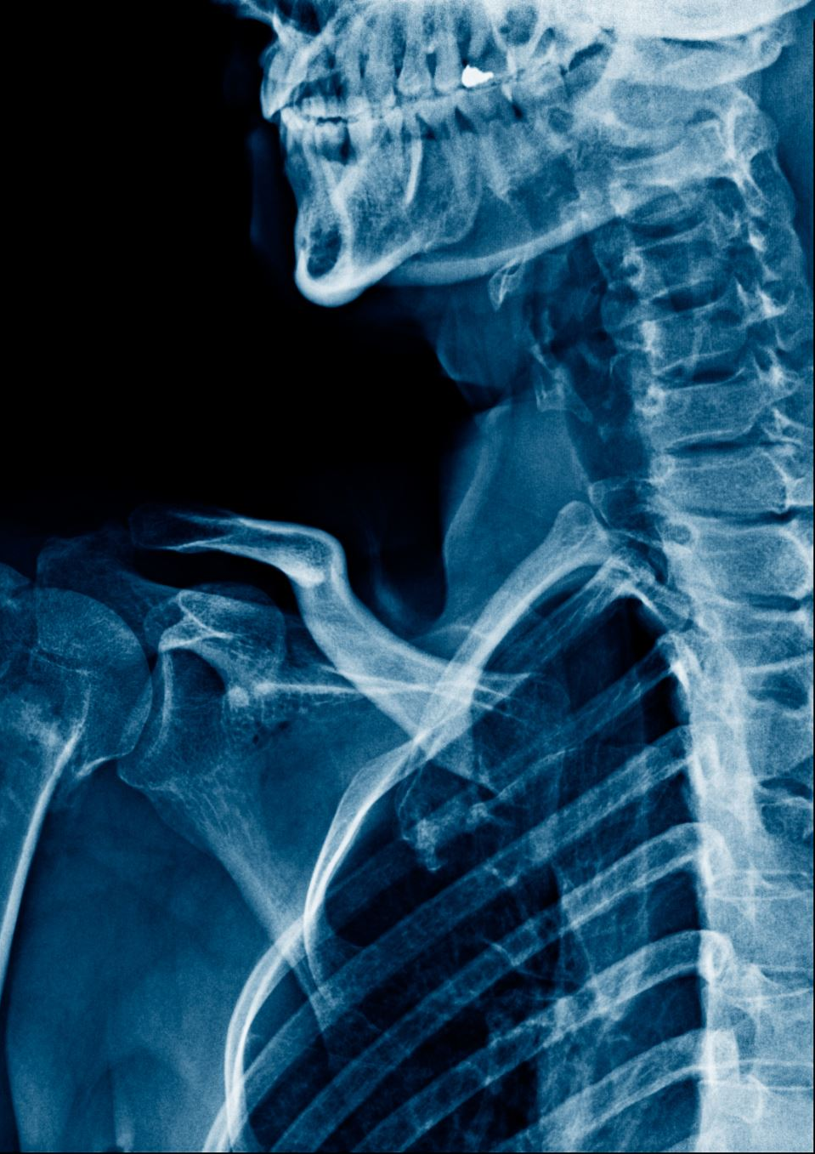
Idea List
Wedge Shaped Fractures of the Spine
Spinal Alignment Lines
Intervertebral Disc Narrowing
Spinal Cord Level Labeling
Indication for Vertebral Osteo Arthristis

Slide 4
Wedge Shaped Fractures of the Spine
Fractures of the vertebrae that occur due to osteoarthritis, a degenerative disorder that leads to a reduction in joint space. This loss of joint space and the deterioration of the intervertebral discs result in vertebral compression. The vertebrae that experience the most flexion in the spine are at the highest risk from compressive forces and friction, as the bones start to rub against each other. Additionally, a decrease in bone density makes the bones more brittle, increasing their susceptibility to fractures and deformities, which can result in a classic wedge shape appearance.

Slide 5
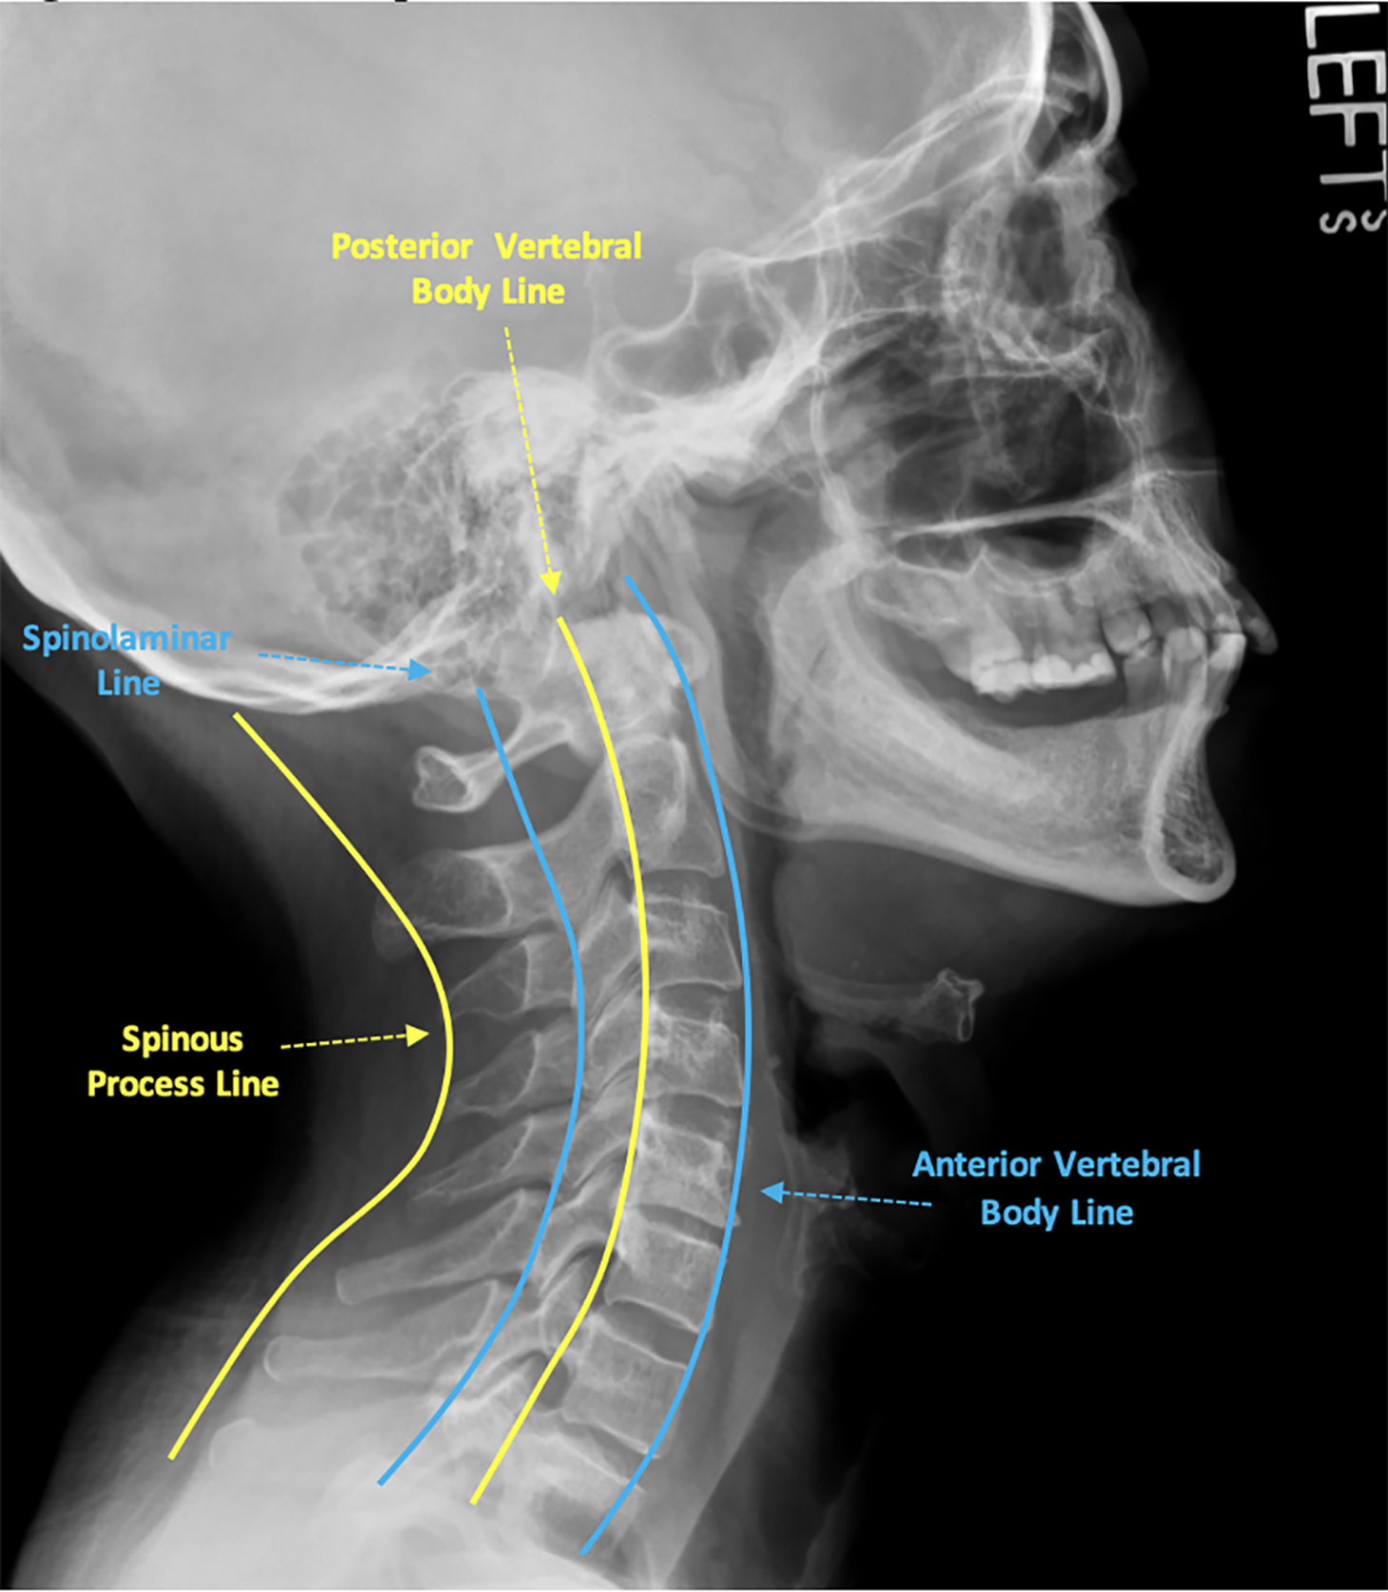
Spinal Alignment Lines
When evaluating cervical spine alignment, it is essential to identify four parallel lines that connect specific structures within the cervical spine:
Anterior Vertebral Line
Posterior Vertebral Line
Spinolaminar Line
Posterior Spinous Line
These lines should demonstrate a gentle lordotic curvature, characterized by smoothness and the absence of step-offs. Any observed malalignment should be interpreted as potential evidence of bony or ligamentous injury.

Slide 6
Intervertebral Disc Narrowing
This condition involves the loss of space between the vertebrae, which occurs naturally with aging, especially in individuals over the age of 50. However, certain conditions, such as osteoarthritis and rheumatoid arthritis, can accelerate this process. The degeneration of the intervertebral discs is often associated with this narrowing of the joint space. As the space decreases, it can exert compressional pressure on the spinal cord or nerve roots, leading to various symptoms, including pain and loss of motor function.

Slide 7
Spinal Cord Level Labeling
The spine is composed of 33 vertebrae, which can be divided into five regions: cervical, thoracic, lumbar, sacral, and coccygeal. Each region contains anatomically distinct vertebrae that serve as important landmarks. This classification helps in identifying the regions of the spine and labeling each vertebra based on its closest proximity to surrounding structures.

Slide 8
Indication for Vertebral Osteo Arthritis
Osteoarthritis is a degenerative disorder that affects the joint space, leading to the loss of articulating cartilage. This loss results in friction between the bones and causes pathological changes in the bone structure. In many cases of arthritis, subchondral sclerosis occurs, which is the hardening of the bone cortex in areas where friction is most pronounced. On X-ray images, this hardening appears as a shiny white marking along the cortex or marginal border of the vertebrae.

Slide 9
Selected Project Ideas
Spinal Alignment Lines (Priority-1)
Wedge Shaped Fractures of the Spine (Priority-2)

